Slide 1
COMPUTER HARDWARE AND SOFTWARE
SUBMITTED BY
Vishal Verma(2019UCO1563)
Rijul Garg(2019UCO1570)
Riju Tejas Singh(2019UCO1572)

Slide 2


PROBLEM STATEMENT
Smart parking system is very beneficial in public places and urban areas which are facing a major problem with regard to the parking system.
This idea can be useful in various areas of the community as the whole process is automated using a variety of strategies and tools. The smart car parking project aims to provide free and easy parking.
LCD displays space availability; ultrasonic sensors keep a check on the number of incoming and outgoing vehicles in the parking lot. Ultrasonic sensors detect parking availability.

Slide 3
OUR SOLUTION
Here we tried to build a hardware + software solution for the basic Parking Problem nowadays we face.
This web + app based solution will help the user to find out whether is their any parking slot available in the parking area or not.
Here for the prototype we had used 4 Infrared sensor that are used to sense the motion of the vehicle in the slot.

Slide 4
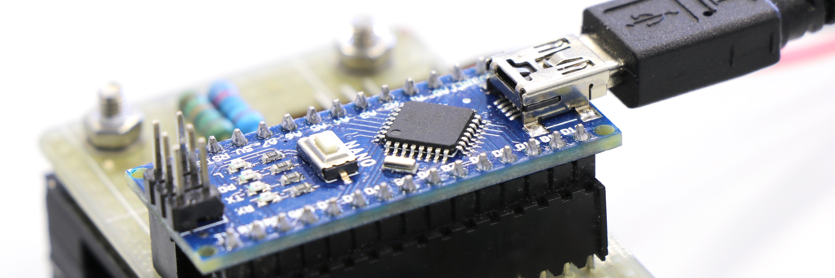
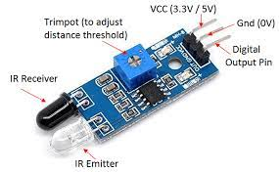
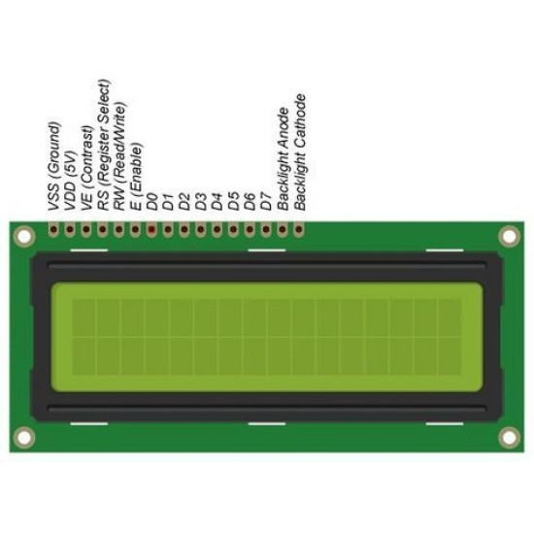
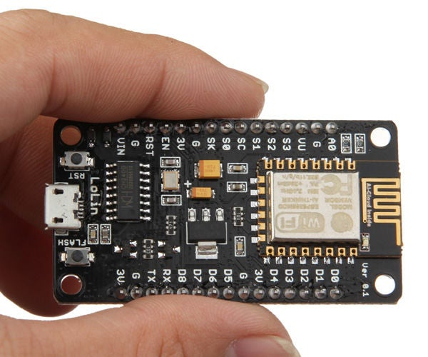
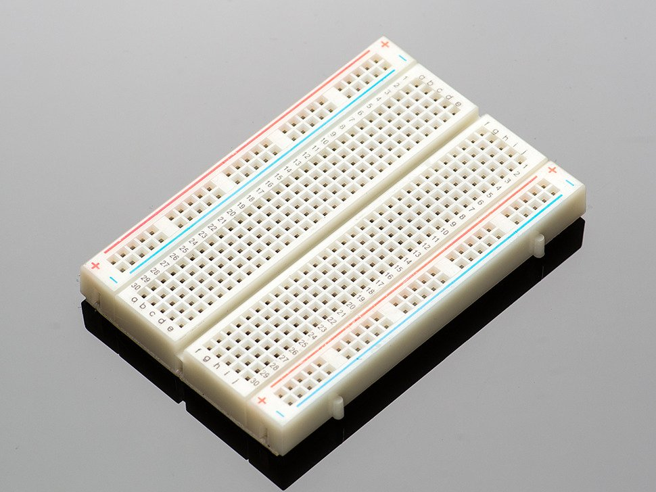
HARDWARE USED
Node MCU
4 Infrared Sensor
Breadboard
Jumper Wires
LCD 16X2 I2c

Slide 5
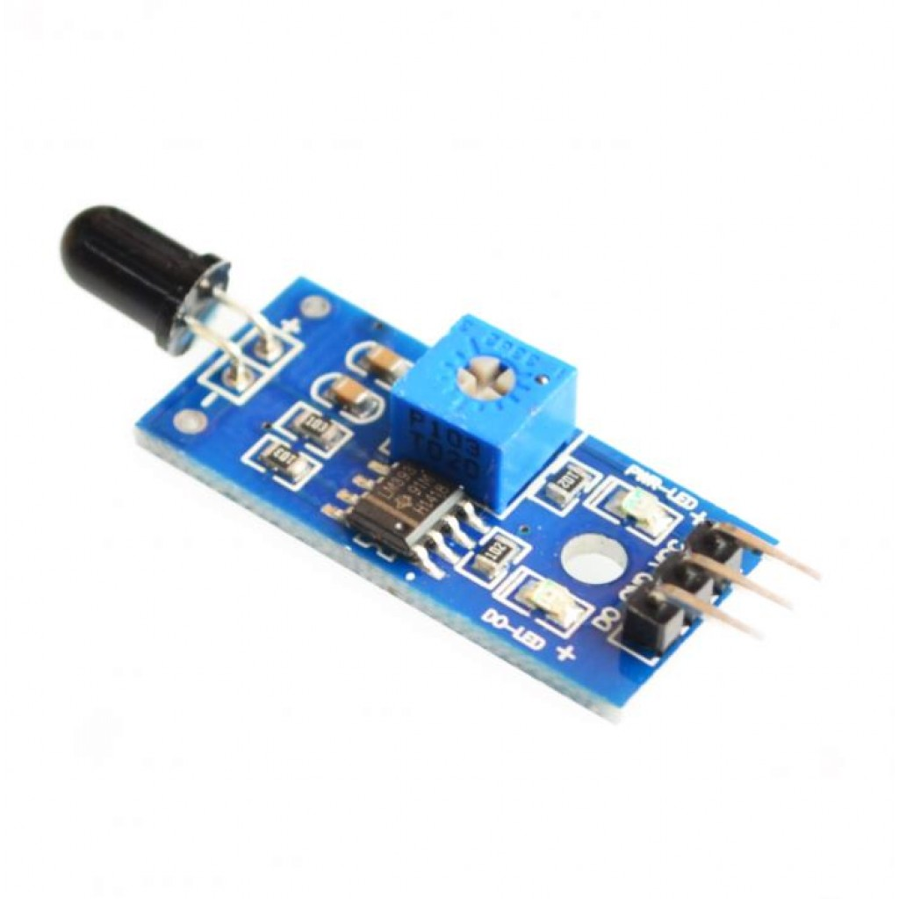
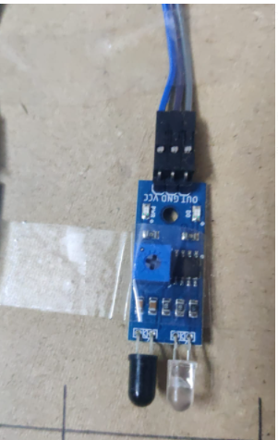
INFRARED SENSOR
An infrared (IR) sensor is an electronic device that measures and detects infrared radiation in its surrounding environment. Infrared radiation was accidentally discovered by an astronomer named William Herchel in 1800.
Anything that emits heat (everything that has a temperature above around five degrees Kelvin) gives off infrared radiation.
PIR sensors are most commonly used in motion-based detection, such as in parking system. When a moving object that generates infrared radiation enters the sensing range of the detector, the difference in IR levels between the two pyroelectric elements is measured.

Slide 6
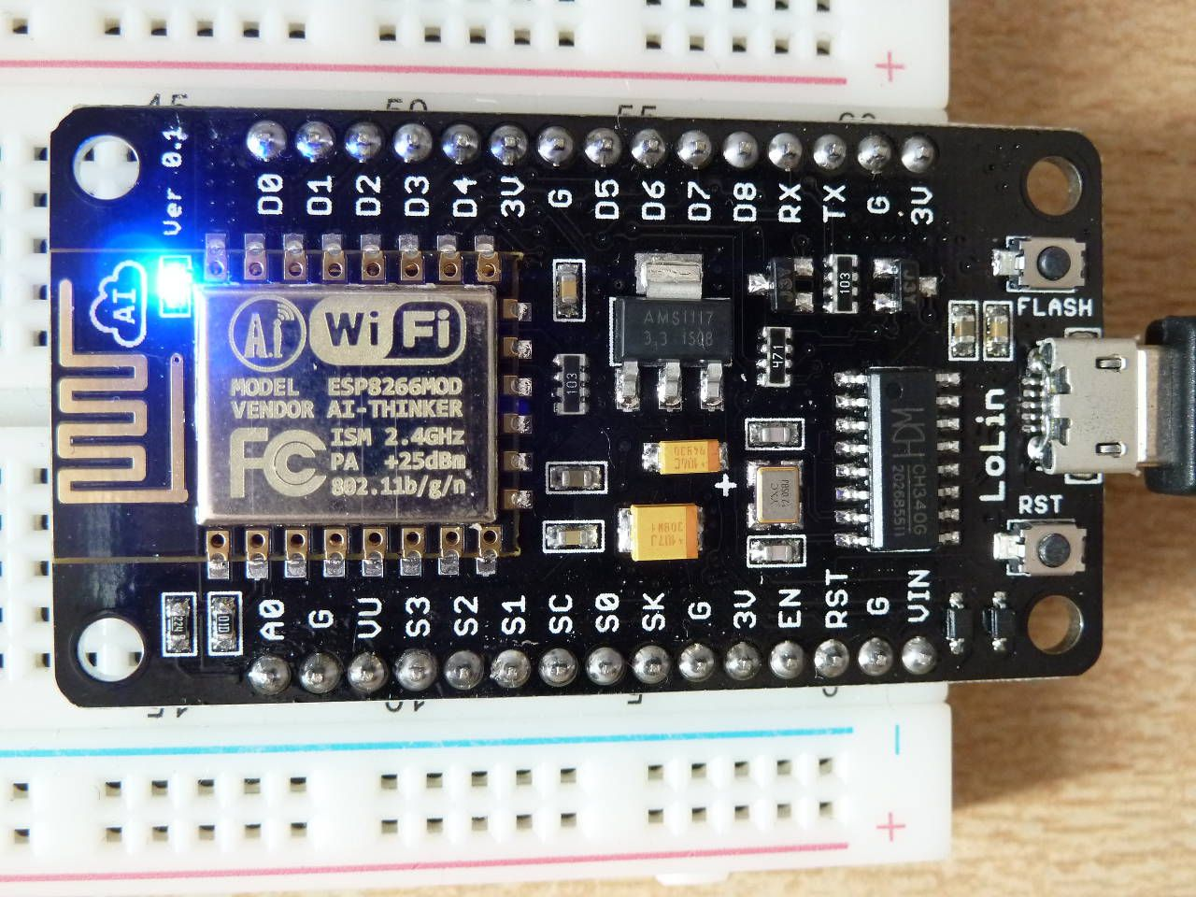
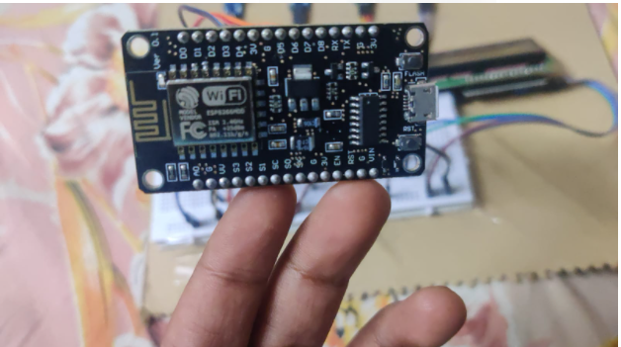
NODE MCU
NodeMCU is an open source Lua based firmware for the ESP8266 WiFi SOC from Espressif and uses an on-module flash-based SPIFFS file system. NodeMCU is implemented in C and is layered on the Espressif NON-OS SDK.
NodeMCU provides access to the GPIO (General Purpose Input/Output) and a pin mapping table is part of the
API documentation.

Slide 7

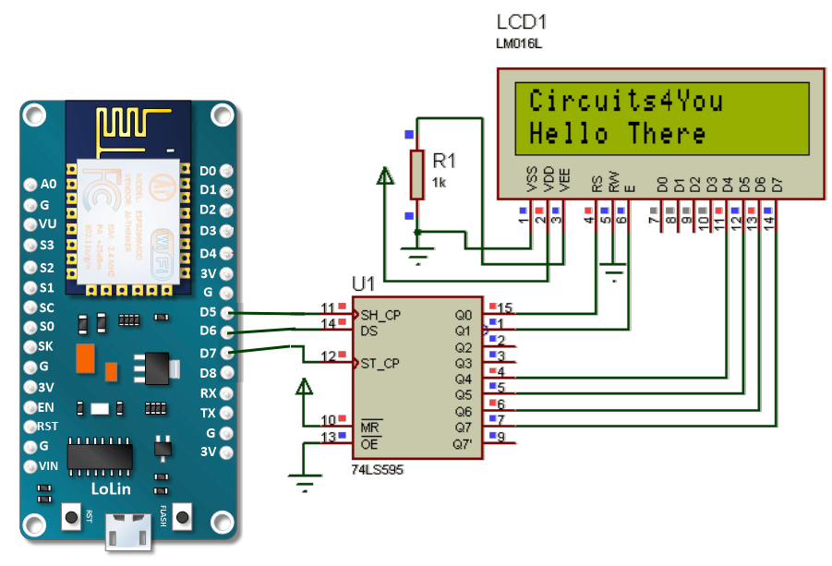
LCD 16X2 i2c
LCD 16X2 i2c

Slide 8
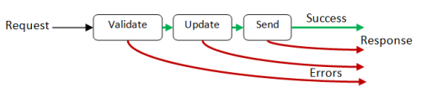
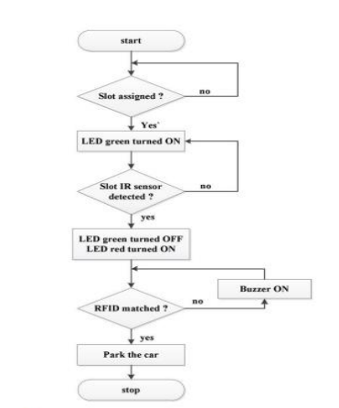
FLOW DIAGRAM
We have used Node MCU ESP8266 in our project which can connect our project objects and let data transfer using the Wi-Fi protocol.
We have used a number of IR sensors in our project to detect the motion of cars which have occupied the parking space. IR sensors work using radar technology by hitting nearby objects with infrared radiation and capturing the presence and movement of the nearby cars.

Slide 9

WORKING of our project
The working of this project revolves around identifying the vacant spots for parking our car so that the process of car parking becomes less cumbersome.
We have used Node MCU ESP8266 in our project which can connect our project objects and let data transfer using the Wi-Fi protocol.
We have used a number of IR sensors in our project to detect the motion of cars which have occupied the parking space. IR sensors work using radar technology by hitting nearby objects with infrared radiation and capturing the presence and movement of the nearby cars.
We can display the real-time information of the nearby cars around us with the help of an LCD monitor by connecting it to our circuit through the use of jumping wires.
Finally, we have send our data to a mobile application through the help of Node MCU ESP8266 by connecting it to an IOT cloud based Think speak server. The end users can get information about the nearby vacant parking spots through the help of this app.

Slide 10
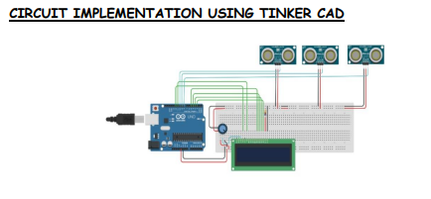

Slide 11
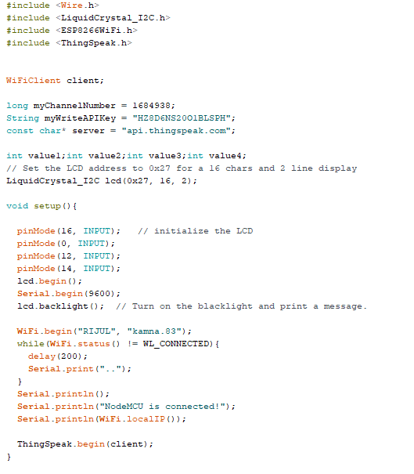
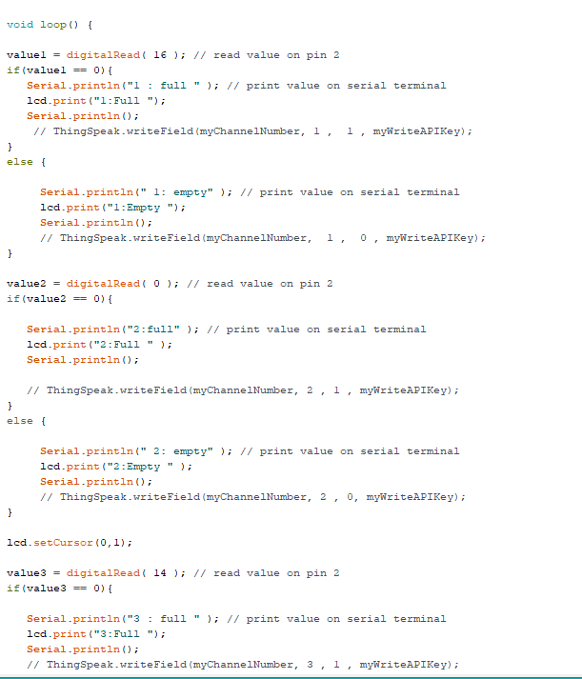
CODE

Slide 12
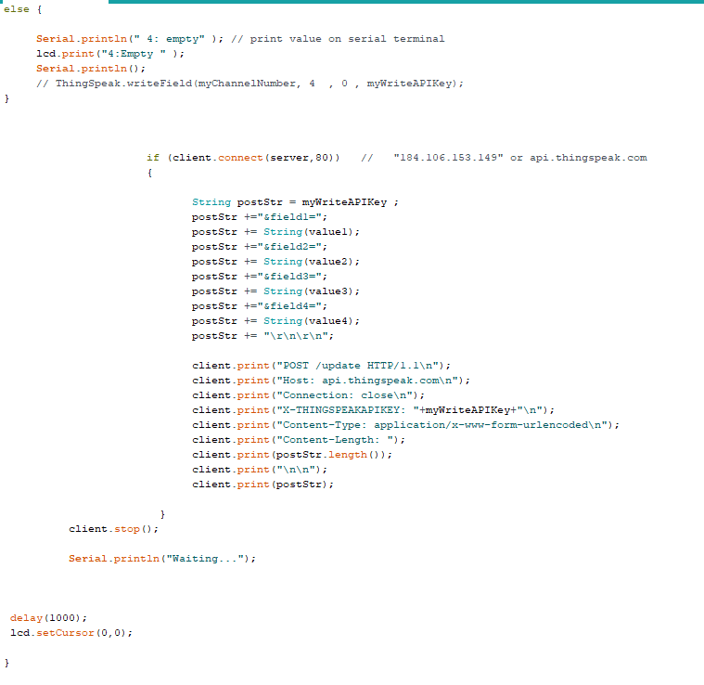
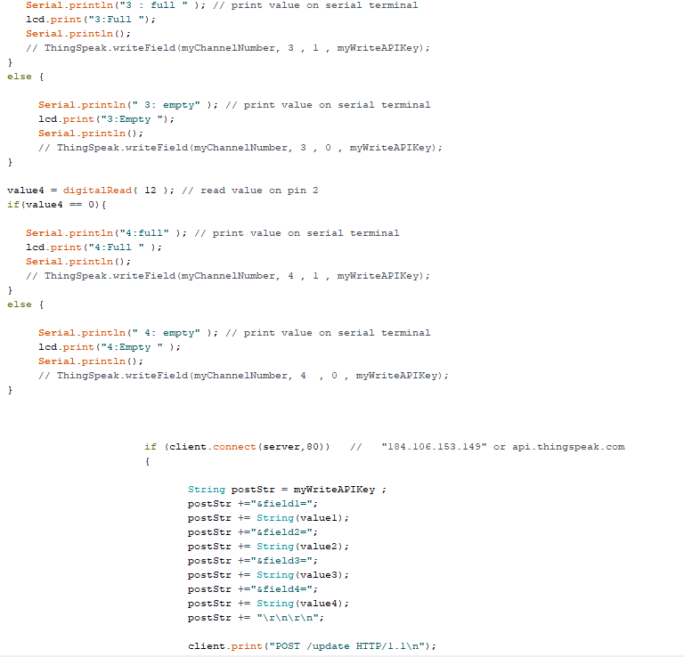
CODE

Slide 13
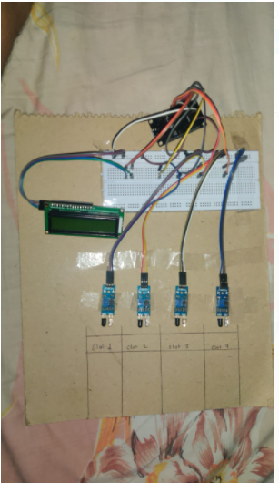
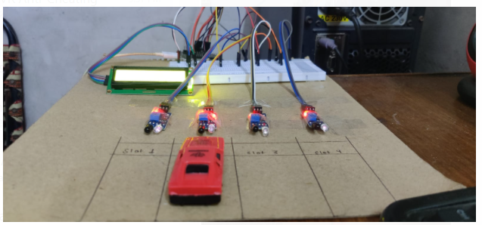
OUR HARDWARE

Slide 14
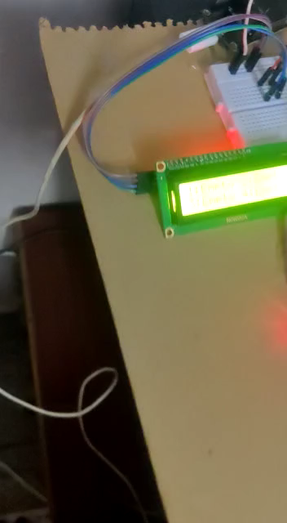
Demonstration Video

Slide 15
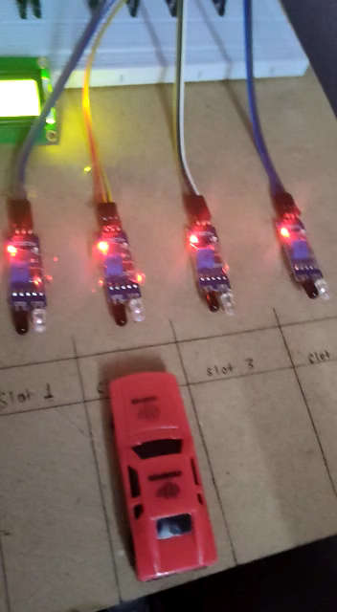
DEMONSTRATION Video

Slide 16
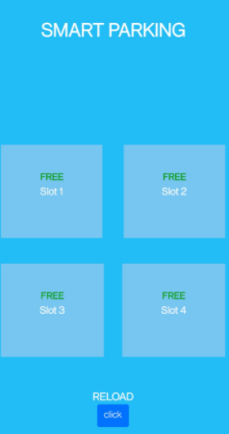
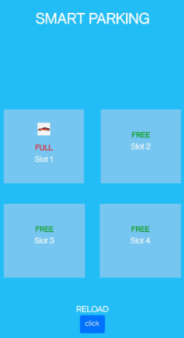
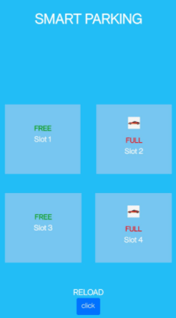
OUR MOBILE APP

Slide 17
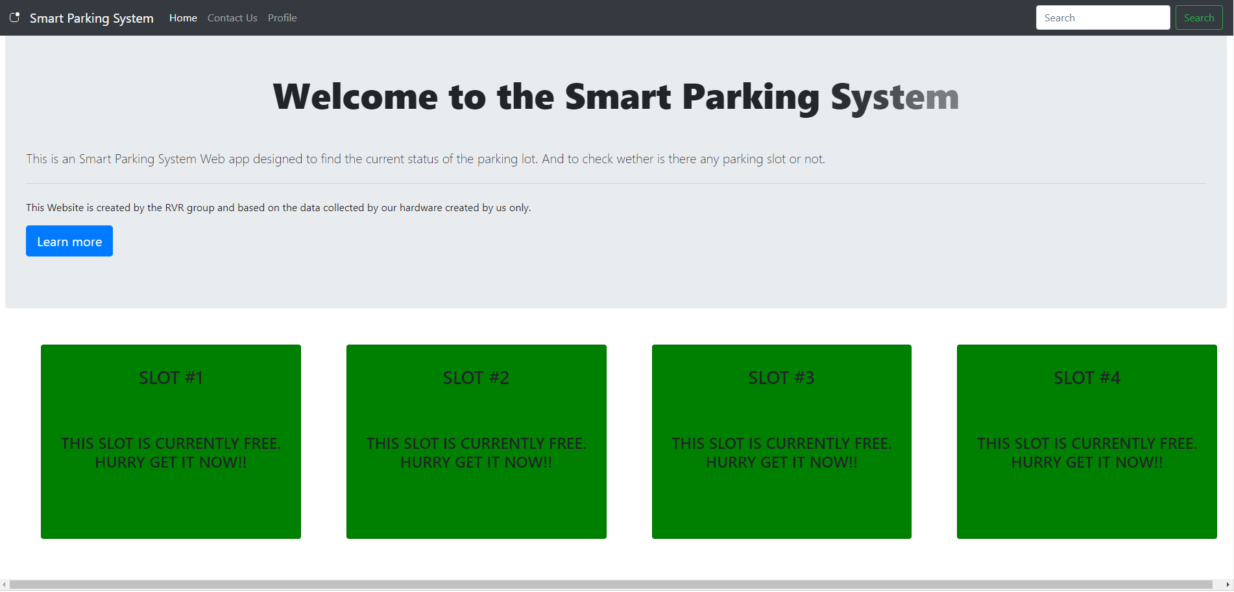
OUR web APP

Slide 18

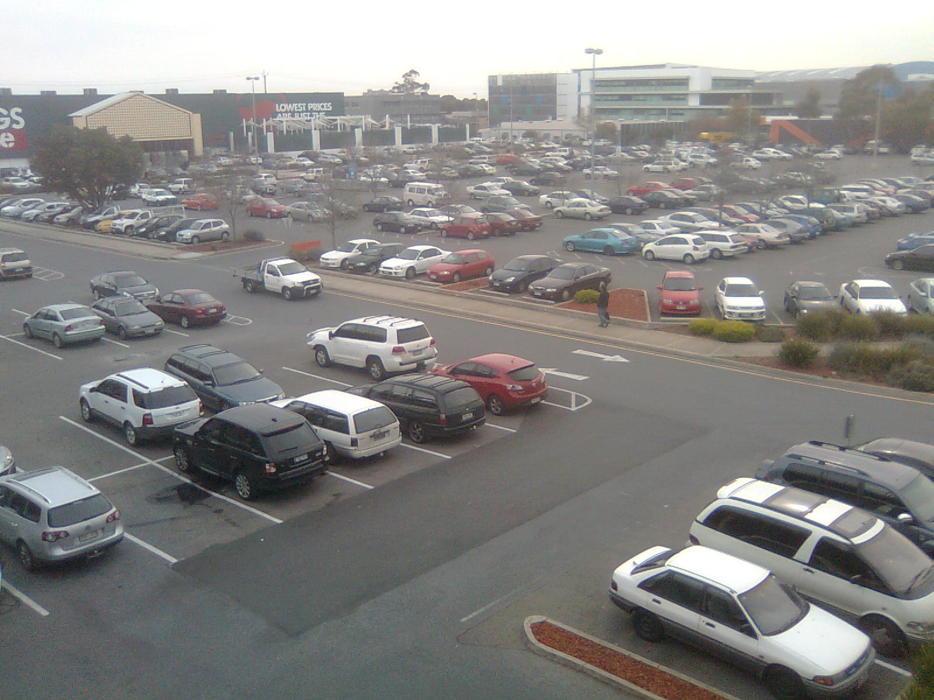
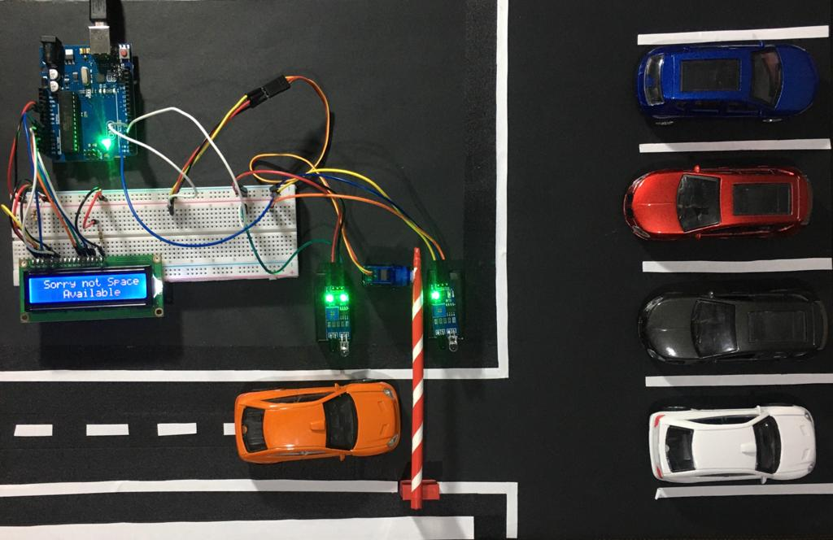
FUTURE ADVANCEMENT
This project can be extended to different parking areas in the locality and the system will recommend you the most nearest parking area where there is any empty slot.
Or this can be extended with the camera surveillance system of the parking area and the parking slot can be distinguished on the bases of the vehicle size like bus, car, and bikes etc.

Slide 19

THANK YOU!!

